Slide 1
LITE ONZ CONTROLLER ACCREDITATION COURSE To be used for Club/OY events
4/5/22

Slide 2
Welcome
Controllers Training targeted at Club Level
Feel free to ask questions, add to discussions
Help yourself to tea, coffee biscuits in your pantry

Slide 3
Introduction
Greg
Orienteering since 1995
Rep at JWOC and WOC
Orienteered in 17 Countries (18 if you count running across the Russian border)
A Grade controller (since about 2004)
Behind the Waitangi Summer Carnival events in 06-08
Now living in Rotorua, still trying to attend orienteering events with young family
I believe in trying to make things easier for our volunteers, with club systems, standard practices, support from ‘experts’, sharing knowledge and useful things others have learnt

Slide 4
FUNCTION OF THE CONTROLLER
The controller is the advocate for the competitor.
Your over-riding concern is “how will this affect the competitor, and is it fair?”

Slide 5
FUNCTION OF THE CONTROLLER
The controller shall ensure that:
The rules are followed
Mistakes are avoided
Fairness is paramount
Health and safety is a primary consideration.
Notes:
You make the call on the day if the event is safe to proceed

Slide 6
FUNCTION OF THE CONTROLLER
The controller has the authority to require adjustments to be made if he or she deems them necessary to satisfy the requirements of the event.
You are the boss!
The buck stops with you!

Slide 7
TASKS OF THE CONTROLLER
Make sure event planning and organisation are happening in a timely fashion.
Assess quality and suitability of the courses
Approve course maps and control descriptions.
Check the map is up to date
Make sure event information is published.
Check venue and suitability of terrain.

Slide 8
TASKS OF THE CONTROLLER
On the Competition Day
Ensure Start is set up correctly (maps in correct boxes)
Ensure event timing is correct ( eg synced start and finish Sport Ident )
Ensure safety of competitors, spectators, event officials and the public.
Deal with complaints

Slide 9
What the Controller is NOT
Not a Course Planner
Not a secondary course planner
Does not plan courses
For club events this gets a bit muddied as the planner can be inexperienced – can assist but need to ensure some process in place so you don’t oversee your own planning mistakes

Slide 10
FUNCTION OF THE CONTROLLER
The controller shall ensure that:
The rules are followed
Mistakes are avoided
Fairness is paramount
Health and safety is a primary consideration.

Slide 11
Example Timeline of Controllers Tasks
Appointed by club – Planner and map assigned
Ensure map is latest and greatest – confirm with planner they have this copy of the map (organise map corrections if it is known that there are some)
Ensure access and organise with planner: talking to landowner about things unique to this event eg cattle in paddock x, electric fences, specific hazards
Talk with planner on how planning is going – give timeline of deadlines eg courses planned by xx/yy so can check before we visit map zz/yy, finalised by aa/zz so there is a week for printing etc
Check courses from planner – give feedback both positive and adjustments required
Visit map, maybe 2 or 3 times (first visit might be before planning – talk to planner) Should check every control site
Check and confirm finalised courses and control descriptions then beautify map(planner may wish to do this)
Sign off on maps and control descriptions for printing
Send map to printers, control description printing, event details to club publicity officer
Check printed maps with enough time for re-printing
Notes:
Some tasks might be performed by others, eg map updates, land owner liaison, printing organisation – pays to check what jobs are taken care of for you (hopefully club has several systems in place to make your job easier)

Slide 12
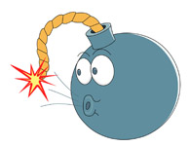
EVENT PLANNING & ORGANISATION
The controller should be involved early in the planning process and works with the planner.
Sufficient time should be budgeted for:
Map production or updates
Course planning, testing, refinement and printing

Slide 13
EVENT INFORMATION
Preliminary information
Should be published ASAP
When, where, what.
Organiser contact details
Embargoed areas
Nature of terrain
This should be all done at club organisation level and probably isn’t required from a controller for a club event
Notes:
Bulletin 1, rule 8.2

Slide 14
EVENT INFORMATION
Final information
Publish about a week before the competition
Directions to event, parking arrangements, distances to arena, starts.
Course closure times
Course lengths and climb
Again hopefully done at club organisation level
Course lengths and climb should be displayed at registration at the event
So should Course Closure – with instructions about returning to finish at this time
Notes:
Bulletin 2, rule 8.3

Slide 15
VENUE & TERRAIN
Venue considerations:
Vehicle access, sufficient all-weather parking?
Landowner/access permission.
Seasonal risks e.g fire, snow
Other users.
Club level considerations
Calving/Lambing, Hunting/Duck Shooting
Specific areas of farm where stock can be kept during event
Other visitors eg Milk Tanker expected – therefore ensure access
Any others……?????
Notes:
See if anyone states cultural

Slide 16
VENUE & TERRAIN
Terrain considerations:
Any wildlife/stock issues?
Any cultural considerations?
Safety/hazards in the terrain.
Note potential hazards that could occur during event
Trees/debris falling if wind picks up
Rivers/streams if high rainfall
You might need to make a health and safety call about not running the event if these occur
Example…….
Notes:
Avoid very green, rocky, cliffy areas unsuitable
Farm animals – do courses need to be designed to leave runner-free areas?
Maori burial grounds/tapu areas? Culturally sensitive areas?
Areas of cliffs? Uncrossable streams/rivers? Tomos? Roads, railways?
MtBO in Whaka when I was controller and storm was due – I was very nervous about falling trees, asked local forest maintenance for their opinion on the Saturday, made call onsite Sunday morning

Slide 17
THE MAP
Arguably the most important aspect of a fair competition.
The map should be as accurate and legible as possible
Older, slightly out-dated maps are fine to use for club events but ensure any map inaccuracies do not affect courses or control placement)
The map should conform to current IOF specifications. Map symbols must be the correct dimensions and separations for the chosen scale. This is the first thing you should check.
Notes:
One of the biggest problems we seem to get in NZ Orienteering is the use of too-small symbols on detailed maps. There is a very good reason for the symbols sizes to be specified as they are. Shrinking them so you can fit an extra 5 20cm high knolls in is not in the competitor’s interest.
Gregs definition – Map is, Legible Symbolic representation of terrain for the purpose of orienteering that is as accurate as possible

Slide 18
THE MAP
Make sure the map has the following:
Scale and contour interval
Magnetic north lines (300m apart i.e 20mm at 1:15,000, 30mm at 1:10,000, 40mm at 1:7,500 etc)
A magnetic north arrow
A scale bar
A legend should be included if there is space. If not, it should be available as a separate item.
Leave room for the course control descriptions.
Notes:
Nice to have, especially for club event with inexperienced runners – but not a major if it does not fit, Good idea for the club to have a copy displayed at registration

Slide 19
THE MAP
The latest version of International Specifications for Orienteering Maps (ISOM) have been official since 1st Jan 2019, and must be used for A-level events.
There is a separate specification for sprint maps (ISSprOM 2019).
Both the above specs are continually updated and available here; https://orienteering.sport/iof/mapping/
There is a very good summary on the ONZ website which you should familiarise yourselves with. https://www.orienteering.org.nz/news/mapping-changes-for-nz-orienteers-june-2017/

Slide 20
THE MAP
It is not expected that every minor or even middle-sized event will use a converted map for some time to come. Some maps are easy to convert and some aren't.

Slide 21
MAP SCALE
Map scales should be appropriate for the target competitors.
Tendency to over-map detail making maps illegible at correct scales. 1:10,000 maps are to be a strict enlargement of the 1:15,000 map.
The controllers judgement takes precedence.
Notes:
Rules 15.2

Slide 22
Runners map scales
EVENT TYPE | AGE CLASS | NORMAL SCALE | ALTERNATIVE SCALE*
Long distance | Elite | 1:10,000 | 1:15,000
 | 16-35 | 1:10,000
 | 14, 40-55, B-classes, AS-classes | 1:7,500 | 1:10,000
 | 10-12A, 10-12B, 60+ | 1:7,500 | 1:5,000
Middle distance | Elite, 16-35 | 1:10,000
 | 14, 40-55, B-classes, AS-classes | 1:7,500 | 1:10,000
 | 10-12A, 10-12B, 60+ | 1:7,500 | 1:5,000
Relay | Open | 1:10,000 | 1:7,500
 | Masters | 1:7,500 | 1:10,000
 | Veterans | 1:7,500 | 1:5,000
 | Short | 1:7,500 | 1:5,000
Sprint | Elite, 16-35 | 1:4,000
 | 40+, AS-classes | 1:3,000
 | 10-12, 60+ | 1:3,000 | 1:2,000

Slide 23
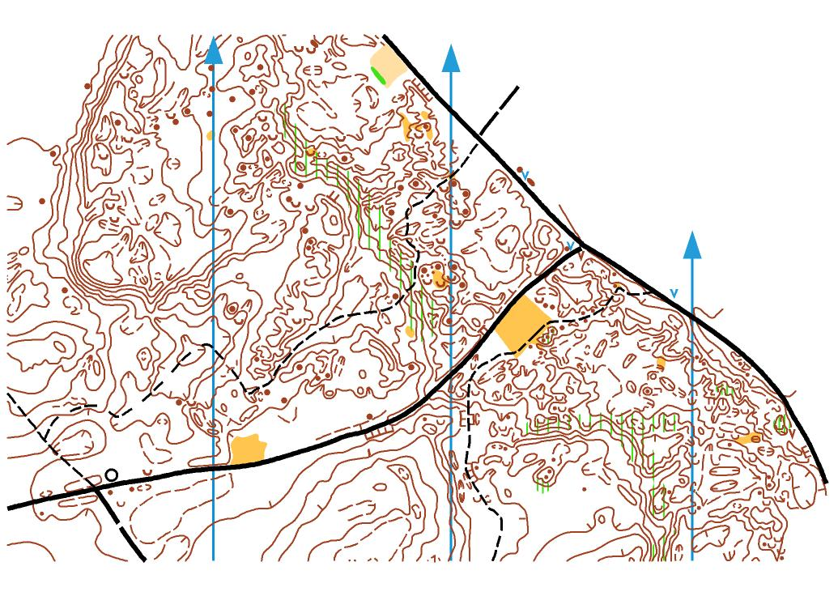
TOO DETAILED

Slide 24
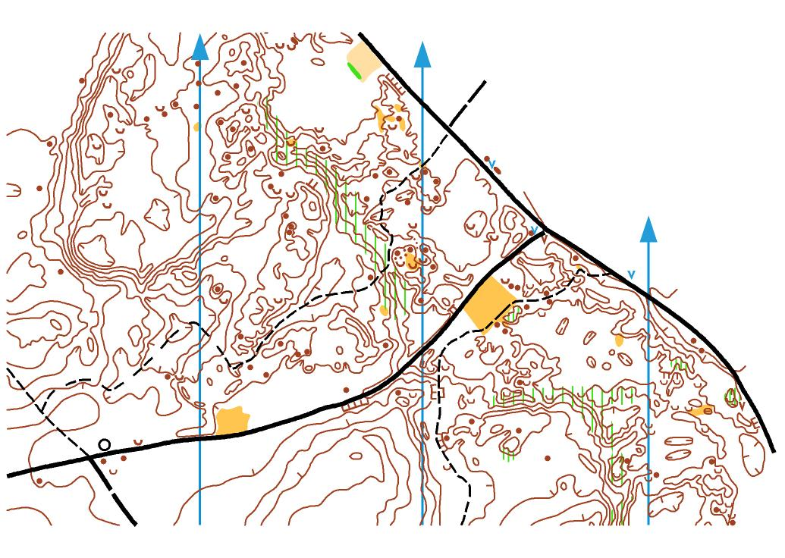
SANS FORMLINES
Notes:
Note knoll sizes

Slide 25
THE COURSE
The controller’s role is to advise and guide the course planner in the design of courses which are fair, an appropriate physical and technical challenge, and which test a full range of navigational skills.
Notes:
See ONZ Rules Appendix 3 – Principles for course planning

Slide 26
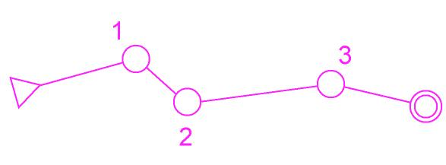
THE COURSE
An orienteering course is defined by the start, the controls, and the finish. Between these points, which are precise locations in the terrain and correspondingly on the map, are the course legs over which the competitor must orienteer.

Slide 27
THE START
The start area should be situated so that waiting competitors cannot see route choices made by those who have started.
The start is marked in the terrain by a control flag with no code and no punching device (perhaps marked with “START”).
Club should have standard equipment that they use for Starts, finishes, map boxes, control descriptions, etc

Slide 28
COURSE LEGS
Good legs offer interesting map-reading problems and possibilities for different route choices.
Within a course, different types of legs should be offered e.g some based on intense map-reading, others on route choice.
Leg length and difficulty should be varied throughout the course. Try to have frequent changes of direction.
A course should have a few very good legs joined by short links designed to enhance the legs rather than a larger number of even but lesser quality legs.

Slide 29
SHORT LEGS
Use short legs with change of direction to add variety and avoid dog legs.
Can use several short legs in a row, to test navigators “smoothness” and stop them looking at route choice to come.
Several short legs can be used at the start to test competitors ability to adapt to the map or at the end to test fine navigation while fatigued.
Can involve route choice or not.
Best in detailed areas.

Slide 30
LONG LEGS
Should involve route choice.
Preferably not just a simple left or right decision. Ideally a variations of several routes.
Ideally the fastest route should be the one with the most navigation.
Is there something big near or past the control that is visible and will ruin the navigation of the long leg.
No one leg should be more than 20% of the course length, lest the result of the race hinge on one decision. However, the two longest legs of a long distance course might be around 33% of the course length.

Slide 31
COURSE LEGS
No leg should contain route choices giving any advantage or disadvantage that can’t be foreseen from the map.
Dog-legs should be avoided.
Courses should not have competitors running the same or similar legs in the opposite direction.
Avoid having legs which encourage runners to cross forbidden or dangerous areas.
Notes:
Dog-legs and opposite directions both potentially unfair as the presence of another competitor may help the runner

Slide 32
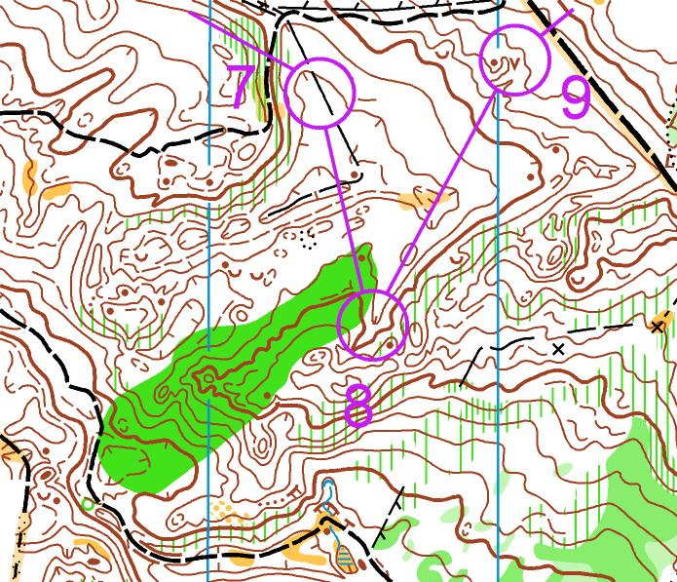
COURSE LEG NO-NOES 1
Notes:
Print the following examples

Slide 33
COURSE LEG NO-NOES 1
Obviously a dog-leg...

Slide 34
COURSE LEG NO-NOES 2

Slide 35
COURSE LEG NO-NOES 2
Not so obvious at first glance

Slide 36
COURSE LEG NO-NOES 3

Slide 37
COURSE LEG NO-NOES 3
Courses/legs in opposite directions.....
Someone approaching P3 may lead someone going to R6 into the control. P2-P3-R7 is a dogleg, as is R5-R6-P4. Even worse if the controls are the same

Slide 38
COURSE LEG NO-NOES 4

Slide 39
COURSE LEG NO-NOES 4
Leg across permanently out-of-bounds area (with no distinct boundary)

Slide 40
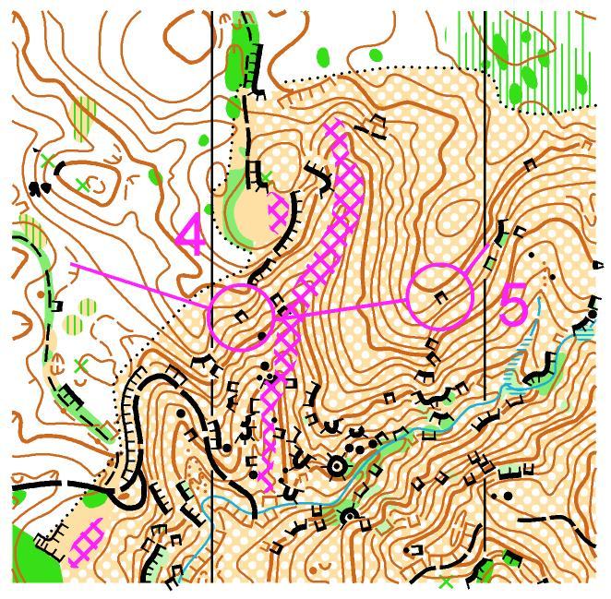
COURSE LEG NO-NOES 5

Slide 41
COURSE LEG NO-NOES 5
Leg across dangerous area – thermal activity in gully

Slide 42
COURSE LEG NO-NOES 6

Slide 43
COURSE LEG NO-NOES 6
Leg too close to undefined edge of map.
The terrain in the unmapped part was the same as the mapped area so no way of knowing you had left the map.
P.S Note control numbers orientated incorrectly

Slide 44
COURSE LEG NO-NOES 7
Notes:
Climb should not be greater than 4% of the length of the shortest sensible route on any course.

Slide 45
COURSE LEG NO-NOES 7
Course legs far too physical for classes on this course
Notes:
Climb should not be greater than 4% of the length of the shortest sensible route on any course.

Slide 46
NO-NOES Summary
No Dog-legs (on harder courses)
No legs that run in opposite directions on different courses
Should not approach controls from opposite directions (well planned too–see below)
No legs across ambiguous or dangerous areas – where there is any possibility for people to enter (see below)
Do not go near undefined edges of the map (see below)
Not too physical (or technical) for the target market
Below
Do not assume that a competitor will do the sensible thing, there will always be someone that does something you would never dream of

Slide 47
CONTROL SITES
The control site is the actual feature in the terrain at which the control is placed.
A control site must be on a feature which is both on the map and in the terrain.
The map must portray the ground accurately in the entire vicinity of the control site.
All distances and directions, from all possible angles of approach, must be correct.

Slide 48
CONTROL SITES
Controls must not be placed on small features which are only visible from a short distance if there are no supporting features on the map. In other words, no bingo controls.
Do not use difficult-to-read control sites especially for older age classes.
Take care with flag placement – on red courses, the feature should be visible before the flag.
A control site which cannot be accurately described should not be used.

Slide 49
CONTROL SITES
Do not hide the flag – good practise to ensure you can walk completely around the control. Trample down vegetation if needed. Don’t place the control hard up against a cliff or bank or behind a tree. Place the control on top of the edge of a pit, not down in the bottom (unless it’s a huge pit).
Orienteering is NOT a treasure hunt

Slide 50
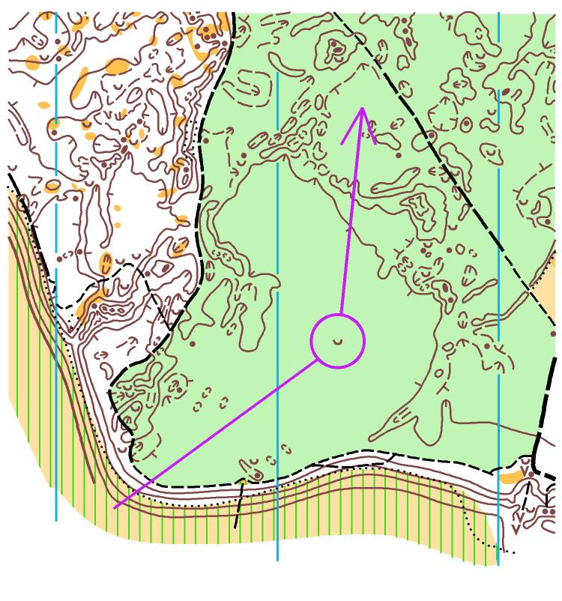
POOR CONTROL SITES

Slide 51
POOR CONTROL SITES
Bingo – low visibility, nothing nearby to navigate off or relocate off.

Slide 52
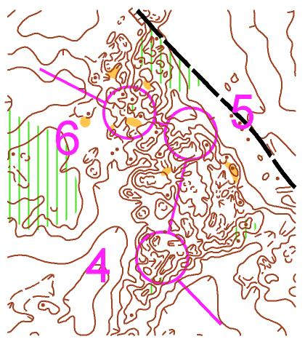
POOR CONTROL SITES
W50/M60

Slide 53
POOR CONTROL SITES
Great few legs if you can read the map - older age classes probably can’t...
W50/M60

Slide 54
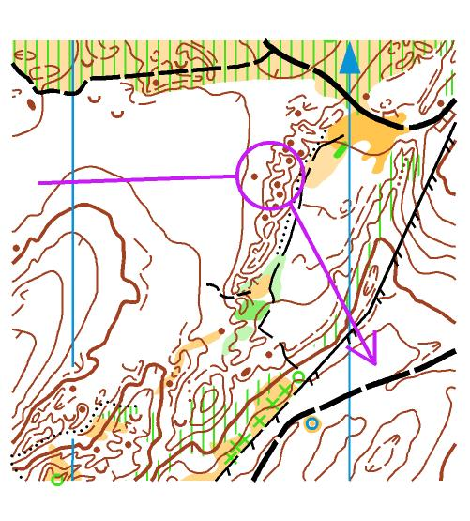
POOR CONTROL SITES

Slide 55
POOR CONTROL SITES
Poor control site:
On the approach side of the hill and probably visible from far away.

Slide 56
POOR CONTROL SITES
Better site:
Not visible from approach direction

Slide 57
PROXIMITY OF CONTROLS
On forest/farm maps controls must be no closer than 30m apart and no closer than 60m unless placed on distinctly different features in the terrain as well as on the map.
On Sprint maps controls must be no closer than 25m [15m straight line]
Notes:
These are good habits
Main thing is not to put controls too close.

Slide 58
PROXIMITY OF CONTROLS
A
1:10,000
Circles are 75m diameter
B

Slide 59
PROXIMITY OF CONTROLS
A
1:10,000
B
Unacceptable – less than 30m apart, even though different features

Slide 60
PROXIMITY OF CONTROLS
A
1:10,000
B
Unacceptable – less than 30m apart, even though different features
Acceptable – more than 30m but less than 60m apart. OK because on quite different features

Slide 61
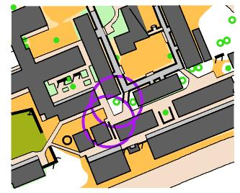
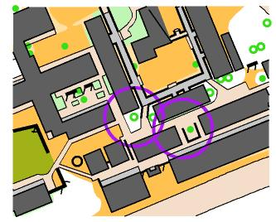
PROXIMITY OF CONTROLS
A
1:4,000
Circles are 24m diameter
B

Slide 62
PROXIMITY OF CONTROLS
A
1:4,000
B
Unacceptable – less than 15m apart, even though different features
Acceptable – less than 30m but more than 15m apart. OK because on different features

Slide 63
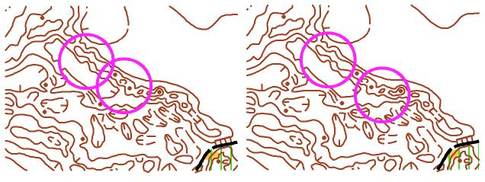
PROXIMITY OF CONTROLS
A
1:10,000
B

Slide 64
PROXIMITY OF CONTROLS
A
1:10,000
B
Unacceptable – on similar features and less than 60m apart

Slide 65
PROXIMITY OF CONTROLS
A
1:10,000
B
Unacceptable – on similar features and less than 60m apart
Acceptable – on similar features but more than 60m apart

Slide 66
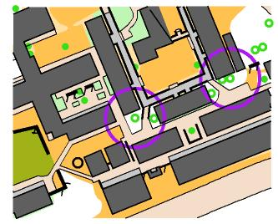
PROXIMITY OF CONTROLS
A
1:4,000
B
C

Slide 67
PROXIMITY OF CONTROLS
A
1:4,000
B
C
Unacceptable – similar features and less than 15m apart
Unacceptable – similar features, less than 30m apart
Acceptable – similar features but more than 30m apart

Slide 68
PROXIMITY OF CONTROLS
However, a word of warning! In practise, 30m is not very far and an oxygen-deprived, sweaty and slightly panicky orienteer may not be able to differentiate between the side of a hill and a depression, for example. The two features may be distinctly different on the map, but not so different in the terrain.
Ask yourself, why do you need two controls so close anyway??

Slide 69
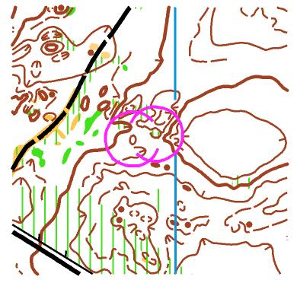
PROXIMITY OF CONTROLS
Real-life example 1: From QB3 2015. In theory, acceptable as the two controls are (just) 30m apart and quite different features. Forest was low visibility, all courses approached from east/south-east.
Why do you need two different sites here?

Slide 70
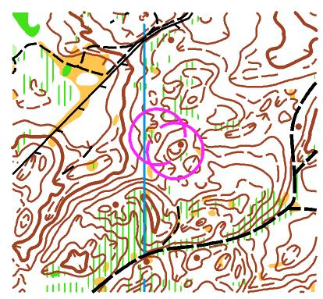
PROXIMITY OF CONTROLS
Real-life example 2: Also from QB3 2015. Not acceptable as the two controls are less than 30m apart even though different features. To make it worse, the NW control was positioned on the SE side of the hill, so even closer to the other control. Again, why do you need two different sites here?

Slide 71
COURSE DIFFICULTY
Consider physical and technical difficulty.
NZ rules – 4 levels of technical difficulty. White, yellow, orange, red.
Take care with the physical difficulty for older and very young age classes.
ONZ Rules appendix 1a and b outlines in detail the technical difficulty levels for both forest and sprint events.

Slide 72
THE FINISH
Ideally have the same last control for all courses
Ensure you have sufficient finish punches.
All finish controls must have flags

Slide 73
THE PURPLE STUFF
Properly known as overprinting symbols.
Include start triangle, circles, connecting lines, control numbers, finish circles and control descriptions.
Also symbols for drinks points, first aid points, crossing points, out-of-bounds areas, dangerous areas.
Correct colour is purple, not pink. Older versions of OCAD define purple as 100% magenta. The colour composition needs to be 80% magenta & 50% black

Slide 74
THE PURPLE STUFF
ISOM 2017 has some changes compared to older versions.
A major difference is that the size of overprinting symbols (as defined in the ISOM 2017 for 1:15,000) now increase proportionally according to scale (to 150% for 1:10,000 and 300% for 1:5,000).
Another new thing is marking the map issue point. If there is a marked route to the start point this is marked with a dashed purple line with a purple bar representing the actual map issue point.

Slide 75
THE PURPLE STUFF
 | Control circle |  | Control number | Start triangle |  | Finish circle |  | Connection line
 | Diameter (mm) | Line thickness (mm) | Arial font Height (mm) | Side length (mm) | Line thickness (mm) | Diameter of each circle (mm) | Line thickness (mm) | Thickness (mm)
1:15,000 | 5.0 | 0.35 | 4.0 | 6.0 | 0.35 | 4.0/6.0 | 0.35 | 0.35
1:10,000 | 7.5 | 0.525 | 6.0 | 9.0 | 0.525 | 6.0/9.0 | 0.525 | 0.525
1:7,500 | 10.0 | 0.70 | 8.0 | 12.0 | 0.70 | 8.0/12.0 | 0.70 | 0.70
Notes:
Course marking guidelines – set up in design program eg OCAD, Purple pen – ask for assistance from club if unsure, there should be an expert who can help

Slide 76
THE PURPLE STUFF
Check all dimensions before you start your course setting project and certainly before cutting circles and lines or shifting numbers around.
Sections of circles and connection lines must be cut where they obscure important detail.
Take care with the placement of control numbers so that they do not obscure important detail.
The location of drinks or 1st aid points must be marked precisely as if they were a control.

Slide 77
CONTROL CODES
Good practice - if controls are in close proximity in the forest, make sure they have very different numbers e.g do not have 46 and 64 close together, or 138 and 238.
Notes:
My first ever DQ in Jan 56 and 65, in a relay and reading the numbers upside-down off a folded map – I wasn’t very happy about it

Slide 78
LINE & NUMBER PLACEMENT

Slide 79
LINE & NUMBER PLACEMENT
White course – line 2-3 covering the track. Numbers covering detail. This a) makes the number hard to read and b) obscures important information

Slide 80
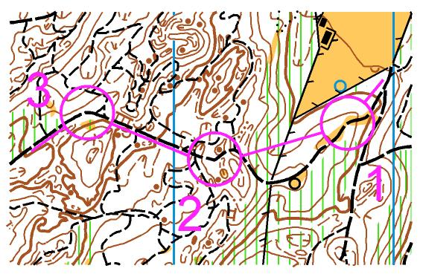
LINE & NUMBER PLACEMENT
Shift line 2-3 off the track. Shift numbers away from detail.

Slide 81
LINE & NUMBER PLACEMENT

Slide 82
LINE & NUMBER PLACEMENT
All three circles obscure detail, as do connection lines.
Numbers are poorly positioned.

Slide 83
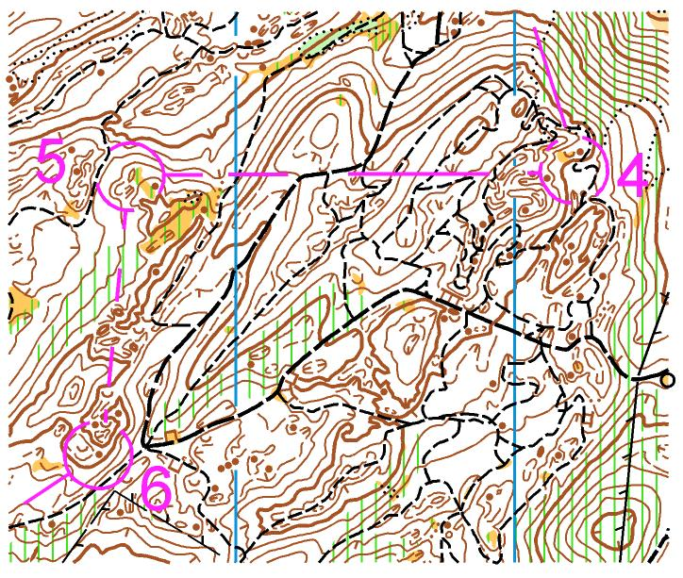
LINE & NUMBER PLACEMENT
Cut circles and lines as required. A circle is still recognisable as such even if there are more gaps than not in the line.
Numbers moved so not hiding detail.

Slide 84
LINE & NUMBER PLACEMENT
World Cup Middle Distance race, Tasmania 2015.
Look carefully at the line to number 7.

Slide 85
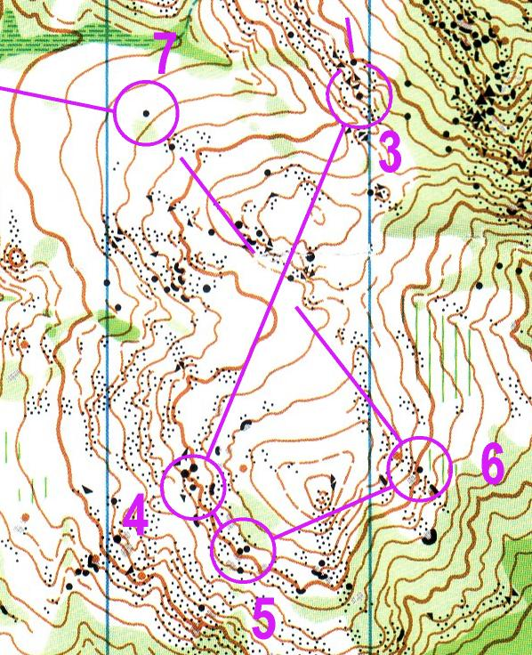
LINE & NUMBER PLACEMENT

Slide 86
LINE & NUMBER PLACEMENT
Connection line to no. 7 completely obscured the boulder just before the control. This boulder is a) very similar to actual control site; b) a potential attack point

Slide 87
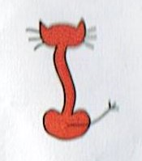
Course Checking for Printing
Do Lines need cutting?
Do circles need cutting?
Should the numbers be moved for better placement?
Do lines need moving on easier courses as to not block the linear feature?
Do I need to create a fancy little symbol for myself and place it on the map?

Slide 88
CONTROL DESCRIPTIONS
IOF pictorial descriptions are used for red courses. Orange course have pictorial AND English descriptions. Yellow and white have only English.
Control descriptions shall be printed on the front of the competition map.
Don’t neglect loose descriptions for club events, gives a more ‘proper’ event feel

Slide 89
CONTROL DESCRIPTIONS
Separate control descriptions for each competitor shall be available at the pre-start.
When printed, the box size of the descriptions is 5-7mm. Too small = too hard to read so try to make them at least 6mm. Just because M21E needs small boxes doesn’t mean we all do.
A control site which cannot be accurately described should not be used.

Slide 90
CONTROL DESCRIPTIONS
Length of course is in km to nearest 0.1km. Climb is in metres to nearest 5m.
Use “side” where the feature extends above ground e.g knoll, boulder.
Use “edge” where feature extends below ground e.g depression, and control at ground level, or where feature extends over a large area e.g marsh, clearing
Use “part” where the feature extends over a significant area and the control is neither at the centre or any of the edges e. Marsh, west part, depression south part.

Slide 91
CONTROL DESCRIPTIONS
State dimensions (in metres) if size of feature on the map is symbolic rather than to scale.
Don’t need to specify location if flag is positioned at, or as near as possible, to the centre of the feature e.g if control is in the middle of the re-entrant, don’t need “middle part” on descriptions.
When the symbol “between” is used in column G, the two features the control is between are shown separately in columns D and E

Slide 92
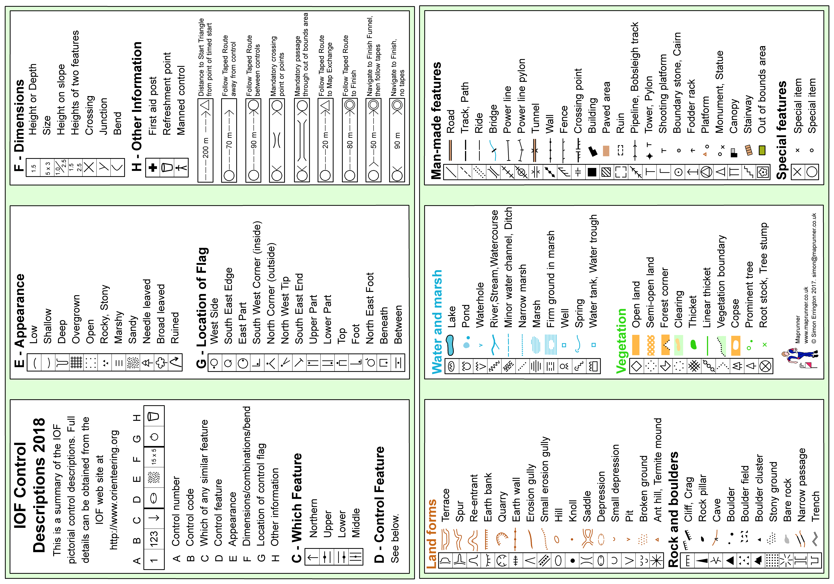

Slide 93
MAP PRINTING
The map must be printed on good, possibly water-resistant paper, 80-120gsm.

Slide 94
MAP PRINTING
Good idea to do a test print using the same printing machine as will be used for the final print job. Do this in a timely fashion to allow for alterations if required.
Check that fine lines such as contours are crisp and clear to read. Check colours are correct.
Preparation of the final print file has a bearing on print quality. Including raster images may have a detrimental effect. Make sure you test print a file prepared in exactly the same way as you will prepare the final files.
Talk to your club ‘admin’, they should have a standard printing method eg OBOP always uses the same Print Shop, they know our paper perferrence and we know their quality

Slide 95
PUNCHING SYSTEMS
“Punching” a control is the mechanism by which a competitor proves he/she has visited the correct control.
In NZ, only SI used. (electronic system)
SI-Air is a touchless system.
Clippers/Clip Cards can be used

Slide 96
SI PUNCHING SYSTEM
The punching system includes:
The competitor “e-card”
The control units
Hardware and software to operate the system
E-Cards
Several generations of e-card, older ones may be incompatible with more modern control units, and hold less punches than newer ones
Notes:
Club should inform you of what system to use for which event, eg some clubs may only use clipcards for small club events

Slide 97
Card | Punches code + time | Start | Finish | Clear | Check | Time to punch | SI Station | Min. firmware | Card numbers
SI 5 | 30 (+ 6) | Y | Y |  | Y | 0.33 s | All |  | 1-499999
SI 6 | 64 | Y | Y | Y | Y | 0.13 s | All |  | 500000 – 999999
SI 8 | 30 | Y | Y | Y |  | 0.115 s | BSF 7 or 8 | v 4.49 | 2000000 – 2999999
SI 9 | 50 | Y | Y | Y |  | 0.115 s | BSF 7 or 8 | v 4.49 | 1000000 – 1999999
SI 10 | 128 | Y | Y | Y | Y | 0.06 s | BSF 7 or 8 | v 5.74 | 7000001 – 7999999
SI 11 LED | 128 | Y | Y | Y | Y | 0.06 s | BSF 7 or 8 | v 5.74 | 9000001 – 9999999
SI AC1 Beacon | 128 | Y | Y | Y | Y | 0.06 s | BSF 7, 8, 11 | v 5.74 | 8000001 – 8999999

Slide 98
SI PUNCHING SYSTEM
Control Units can be configured as clear, check, start, control or finish units
Control Units have
Internal clocks, accurate to about 1 second per day.
Batteries
Firmware (internal software)
Back-up memory

Slide 99
SI PUNCHING SYSTEM
The units are generally in Stand-by mode. When a unit is punched (and that first punch takes a relatively long time – up to 1 second), the unit switches to Active mode (wakes up). The unit then operates normally until the limit of the Stay Active time is reached. But any further punches reset that countdown, so the unit only switches back to Stand-by mode 2 hours (or whatever the Stay Active Time has been set to) after the last person punched it.
For bigger events, you need to wake the controls up so the first competitor through is not disadvantaged by the relatively long time it takes to wake up the control.
Notes:
Not a concern for club events

Slide 100
SI PUNCHING SYSTEM
Before competition you must time synchronise the units – this is vital, especially for the start and finish units.
Use a SI master unit to do this (ask the SI guru in your club)

Slide 101
SI PUNCHING SYSTEM
What actually happens during the punching process:
Competitor inserts card into the hole in the unit or waves their SI-Air card over the unit
The unit reads the competitor’s card (this is very quick)
The unit writes the control code and time into the competitor’s card (this is the ‘longest’ process)
The unit reads the competitor’s card to verify that it has been written correctly
The unit bleeps and flashes and writes the card number and time into its back-up memory.
Competitor withdraws card

Slide 102
SI PUNCHING SYSTEM
It is the competitor’s responsibility to ensure the punch has registered by not removing the e-card until the feedback signal has been received.
If no feedback is received, the back-up punch must be used.
(A back-up needle punch must be provided at each control).

Slide 103
PUNCHING SYSTEMS
If a punch is missing or unidentifiable, the competitor shall not be placed unless it can be proven that this is due to no fault of the competitor.
For Sport-ident, this means:
1. If the control appears not to be working the back-up punch must be used, and if no punch is recorded the competitor is DSQ
2. If you punch too fast and the e-card does not register the punch, you will be DSQ (even if the control unit registered your presence)

Slide 104
PUNCHING SYSTEMS
If there is a problem with a control (misplaced or stolen) to such an extent that no acceptable result can be produced for the competition, then the course must be declared void. It is tempting to try to ‘correct’ the problem by removing the splits either side of the relevant control, but this means that competitors are not being measured over the planned course and introduces distortions such as unfairly benefiting runners who lost time on the subsequent control.

Slide 105
PUNCHING SYSTEMS
ONZ rule 24.10 says The results must be based on competitors’ times for the whole course. It is forbidden to eliminate sections of the course on the basis of split times unless the section has been specified in advance (e.g. a short section containing a busy road crossing).

Slide 106
TIMING AND RESULTS
Punching start or timed start?
Punching start more flexible but not appropriate for major competitions
It is possible to use a timed start for most, but allow those who need flexibility (e.g. officials, split starters etc) to use a punching start.
Some results software has an option which controls whether a punching start overrides the allocated start time.

Slide 107
TIMING AND RESULTS
Provisional results shall be displayed in the finish or assembly area during the competition.
Official results (approved by the controller) shall be published ASAP.
Notes:
Not really a concern for club events

Slide 108
CANCELLING A COMPETITION
IOF Rule 26.12
The organiser must stop, and postpone or cancel a race if at any point it becomes clear that circumstances have arisen which make the race dangerous for the competitor, officials or spectators. Also where there has been a death or the discovery of a body.
IOF Rule 26.13
The organiser must void a race if circumstances have arisen which make the race significantly unfair.

Slide 109
CANCELLING A COMPETITION
Sporting fairness implies that the competitors and the public should be prepared to accept that the races cannot be 100% fair. There will always be an element of luck, especially in a sport such as orienteering taking place in an outdoors environment.
Orienteering is a complex sport to organise and there will sometimes be slight imperfections – for example with the map or the control descriptions. A race should not be voided just because of a minor technicality.

Slide 110
CANCELLING A COMPETITION
Key considerations
Has the problem affected the results so badly that the race is no longer perceived by the competitors, the public and the media as reasonably fair with credible results?
Is it probable that the results will be challenged and the challenge upheld?
Does the perceived unfairness outweigh the requirement to declare a result and celebrate the winners?

Slide 111
CANCELLING A COMPETITION
Consider:
Proportion of field affected. 10% or more indicates race is no longer fair
Has problem seriously affected placings of leading competitors/potential medallists?
Is it fair to competitors not affected by the problem to void the race?
Status of event? WRE, qualification race, trial, local event?

Slide 112
CONTROLLING CONUNDRUMS
The NZ Secondary School champs is a selection trial for the team to go to Australia later in the year. A control is incorrectly placed. Competitors approaching it from route A find it easily and carry on. Those coming from route B lose considerable time and some don’t find it at all. Someone suggests you “remove the affected splits” and recalculate the times. What do you do?

Slide 113
CONTROLLING CONUNDRUMS
At a “have-a-go-day” in the local park, someone steals a control half way through the event. Luckily it’s one located in a very obvious site and no-one loses much time, but half the competitors record a mp due to the missing punch. The mother of one young boy complains that her son is very upset about this. What do you do?

Slide 114
CONTROLLING CONUNDRUMS
At the World Cup Sprint event held in NZ for the first time, an official guarding a control takes a toilet break and someone steals the control. Nine runners are unable to punch the control despite being certain they are in the correct place. The official records the chest numbers of 3 of these runners (6 snuck through already) and in the meantime finds the control and replaces it. What do you do?

Slide 115
CONTROLLING CONUNDRUMS
The NZ Champs long distance race is held in a forest with no suitable arena. In an effort to improve spectator value, the organisers build a temporary bridge across a stream so that runners can cross from the forest to the local athletics oval where the last controls and finish are. A storm which was forecast for the last 3 days eventuates, and by midday the stream is a raging torrent and the bridge becomes unsafe. Later runners are directed to a road bridge 500m downstream where they can cross and then access the oval. What do you do?

Slide 116
CONTROLLING CONUNDRUMS
The South Island Champs is held in a steep, dense, native forest in Fiordland. Race day dawns and it is pouring with rain. 5/18 of the M21E field are unable to finish the course because their maps disintegrate. A complaint is made that the plastic bags are too thin and not strong enough to withstand the competition conditions. What do you do? (The bags used were 30 microns, the paper 80gsm)

Slide 117
Mistake Minimisation
One key responsibility of the controller is to ensure that there are no mistakes…. What kind of mistakes?
Here systems and standard practices can help reduce the chance of a mistake happening
Notes:
Wrong version of map used
Control codes where never updated with correct club codes
Wrong courses get sent to printers
Control put out in wrong place
Wrong control code used/swapped

Slide 118
Mistake Minimisation
Some example systems you could use
Version control on files
Always save with name including yymmdd_hhmm
Course checking system
First cut circles on master
Second cut lines leg by leg, course by course
Third move numbers, leg by leg, course by course
Control put out, 2 people split in half
Each put half of the controls out
Each put SI box on others controls
This checks placement and control codes

Slide 119
Anybody Anything to Add
Hopefully made it this far in time and with everyone still awake
Anyone have any questions or something to add?
Following session will look at courses, technical levels as described in the course setting guidelines
THANKS

Slide 120
Welcome Back
This session will look at courses, specifically the technical levels as described in the course setting guidelines

Slide 121
Four Technical Levels
For a non sprint event there are four levels of difficulty
White
Yellow
Orange
Red

Slide 122
Sprint Technical Levels
For a sprint event there are three levels of difficulty
Easy
Moderate
Difficult

Slide 123
This session
In this session we will look at the traditional colour levels
These can loosely be applied into the sprint levels as well.
Question – If we look at a 5 course club event, White, Yellow, Orange, Short Red, Long Red, Which is the hardest to set….?
Second hardest?
Notes:
Talked about the both physical and technical hardness between a course for M/W70 and elite
So who would these courses be for at a club event?

Slide 124
Definitions - White
WHITE COURSE Courses must follow drawn linear features (tracks, fences, streams, distinct vegetation boundaries, etc.). A control site must be placed at decision points (e.g. turning points such as a track junction, or a change in the type of linear feature - from following a track to following a stream). All control markers must be visible from the approach side. Where the course has to deviate from the handrail feature (e.g. to cross through a forest block), the route must be marked all the way until a new handrail feature is reached. The Start Triangle must be on a linear feature. If no such feature is available, then there must be a taped route all the way from the start to a linear feature (i.e. the first control). Compass use is limited to map orientation only. No route choice is offered. Doglegs are permitted.

Slide 125
Definitions - Yellow
YELLOW COURSE Control sites must be on or visible from drawn linear features (tracks, fences, streams, distinct vegetation boundaries, etc.) but preferably not at turning points. This gives the opportunity to follow handrails or to cut across-country (i.e. limited route choice). Control sites must be visible from the approach side by any reasonable route. Compass use is limited to rough directional navigation. Contour recognition is not required for navigation but simple contour features may be used for control sites. Doglegs are permitted.

Slide 126
Definitions - Orange
ORANGE COURSE The course should have route choice with prominent attack points near the control sites and/or catching features less than 100 m behind. Control sites may be fairly small point features and the control markers need not necessarily be visible from the attack point. Exit from the control must not be the same as the entry (doglegs are not permitted). Simple navigation by contours and rough compass with limited distance estimation required. The use of a chain of prominent features as "stepping stones" is encouraged.

Slide 127
Definitions - Red
RED COURSE Navigation must be as difficult as possible with small contour and point features as preferred control sites (no obvious attack points, no handrails, etc.). Control sites should be placed in areas rich in detail. Route choice should be an important element in most legs. Doglegs are not permitted. For older age classes, extra care must be taken so that navigation is still technically difficult, but the terrain and route choices are less physically challenging. Courses should avoid, to the extent possible, excessive climb, high fences or fences that are difficult to cross, steep erosion gullies and rough terrain that is physically challenging to get through. Note: It may be impossible to set RED courses on some maps.

Slide 128
This session
Ask again after the definitions…..
Question – If we look at a 5 course club event, White, Yellow, Orange, Short Red, Long Red, Which is the hardest to set….?
Second hardest?
Notes:
I think Orange and Yellow – White shouldn’t be hard as the definition is so clear

Slide 129
WHITE COURSE
Courses must follow drawn linear features
A control site must be placed at every decision point (which may be closer than the minimum separation distance) Is there something that could be done here?
All control markers must be visible from the approach side.
Where the course has to deviate from the handrail feature the route must be marked all the way until a new handrail feature is reached (i.e taped route)
Notes:
Decision points need a common sense interpretation

Slide 130
WHITE COURSE
The start triangle shall be on a linear feature. If no such feature is available, then there must be a taped route all the way from the start to a linear feature (i.e. the first control).
Compass use is limited to map orientation only.
No route choice is offered.
Doglegs are permitted.
Used for M/W10, M/W12B

Slide 131
WHITE COURSE TIPS
Keep it simple and safe, the goal is for everyone to finish.
Follow a child around a white or yellow course to get an idea of how young children orienteer.
Consider safety of young children – avoid water hazards such as deep stream crossings, roads with traffic etc. Remember children do not always assess danger in the same way as an adult.

Slide 132
WHITE COURSE TIPS
Try to make the course exciting – don’t just run them around a square of forest roads. Use taped routes to connect up different types of linear features.
Make sure your linear features are obvious on the ground and map i.e no vague old MTB tracks.
Place white course controls so that the competitor is led in the right direction for the next leg. Consider using sad/happy faces to help.

Slide 133
WHITE COURSE TIPS
1:7,500 scale or bigger
Written control descriptions on the map
Legend on the map
May need a different (more obvious and visible) start triangle from the other courses.

Slide 134
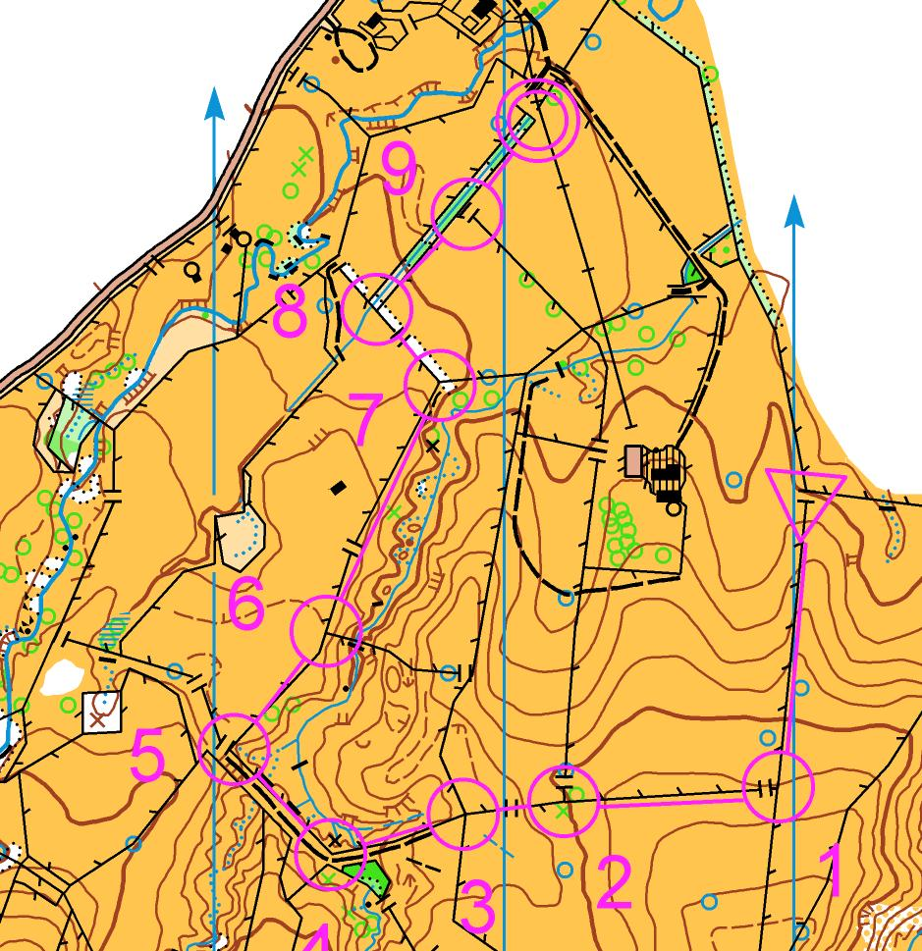
BORING WHITE COURSE

Slide 135
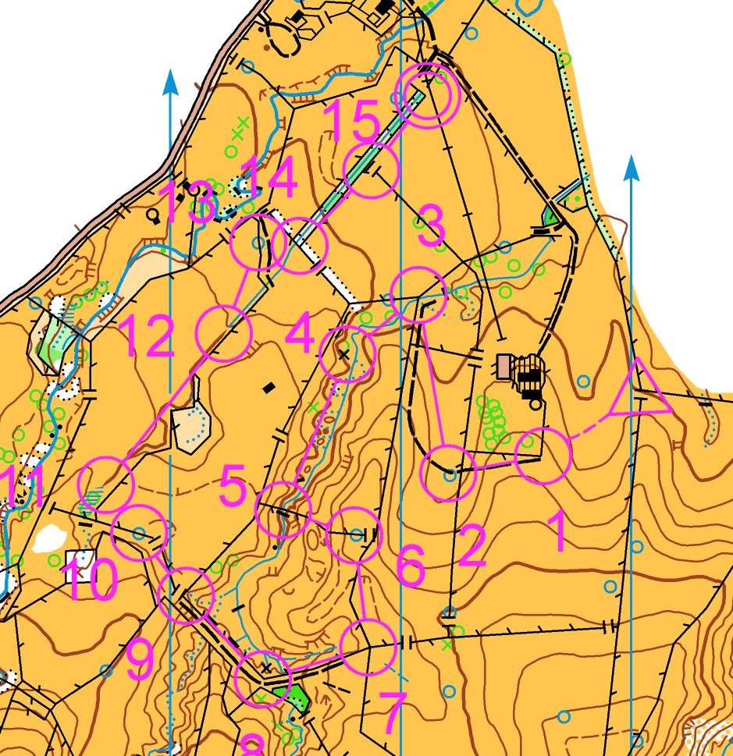
FUN WHITE COURSE

Slide 136
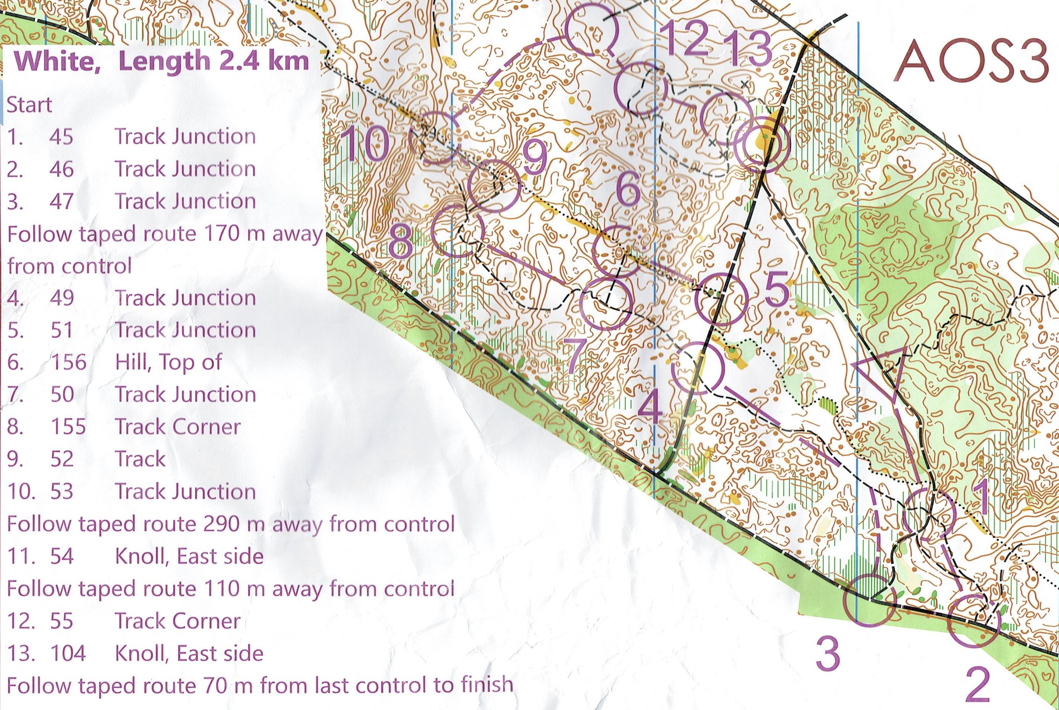
WHITE COURSE?
Notes:
Interesting white course (taped legs, changing direction
BUT Not all decision points have a control – end of tape from control 3,
and control 9 is between decision points, plus description is track?
Control 6 is not on the linear feature, but a contour feature just off, not visible unless looking directly at it – not what a white course running does

Slide 137
YELLOW COURSE
Control sites must be on or near (<50 m) drawn linear features but preferably not at turning points. This gives the opportunity for limited route choice.
Control sites shall be visible from the approach side by any reasonable route.
Compass use is limited to rough directional navigation.

Slide 138
YELLOW COURSE
Legs should not require distance estimation Make sure controls have obvious, easily identified attack points.
Contour recognition is not required for navigation but simple contour features may be used for control sites.
Doglegs are permitted.
Used for: M/W12-A, M/W-14B, adult C classes

Slide 139
YELLOW COURSE TIPS
Incorporates two progression levels for the competitor from White courses
First is choosing which handrails and making decisions at junctions without a control to guide you.
Still needs that “safety” element discussed in white courses where features are obvious etc
Next level is to give safe opportunities for people to test and improve their navigation by cutting corners.
Better navigators should be faster cutting the corner.
Fine navigation is not required, searching for the control is not our sport!

Slide 140
YELLOW COURSE TIPS
Encourage route choice
Common to use some white controls...but often setters are lazy and the courses are too similar. People often do both courses and feel a bit disappointed if yellow is the same as white but missing every second control.
You will use almost half your controls on the White and Yellow courses sometimes! Don’t be surprised by that.
Cross country routes should be in easily navigable terrain both on the ground and on the map.
Like white, variety is still key to fun. Don’t just follow fences.
Only takes one leg/control to ruin a course at this level.

Slide 141
YELLOW COURSE TIPS
1:7,500 or less,
Written control descriptions on map
Legend on map
May need a different (more obvious and visible) start triangle from the other courses.
Can have some legs that are too easy...but no legs that are Orange or Red.

Slide 142
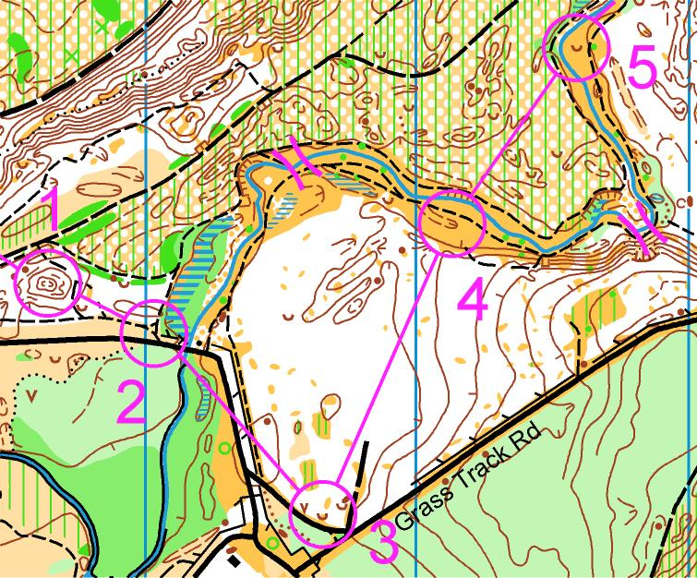
BAD YELLOW LEGS

Slide 143
BAD YELLOW LEGS
Leg 2-3 – along main access road to event. Traffic hazard.
Leg 3-4 – probably a bit on the hard side.
Leg 4-5 – temptation is to try to cross the river (which is deep and fast-flowing after rain).

Slide 144
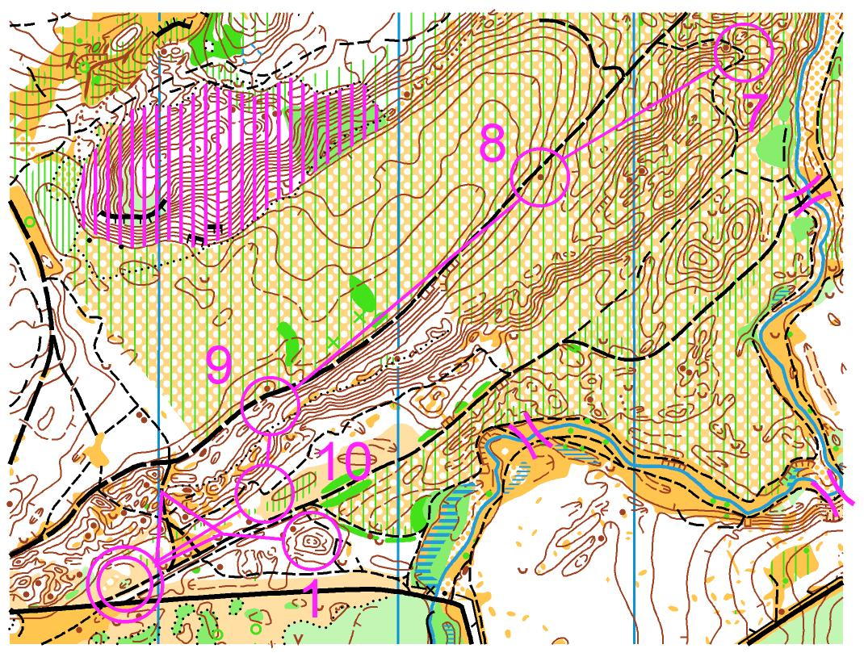
BAD YELLOW LEGS

Slide 145
BAD YELLOW LEGS
Leg 7-8-9 – no attack point for 8 or 9, children will run straight past control.
Leg 9-10 – TERRIBLE yellow leg. Requires contour reading ability to go straight. If they go around, they have to run through the start on the way to 10 and back to finish (which is very confusing).
Too cluttered with no.1, 10, start and finish so close.

Slide 146
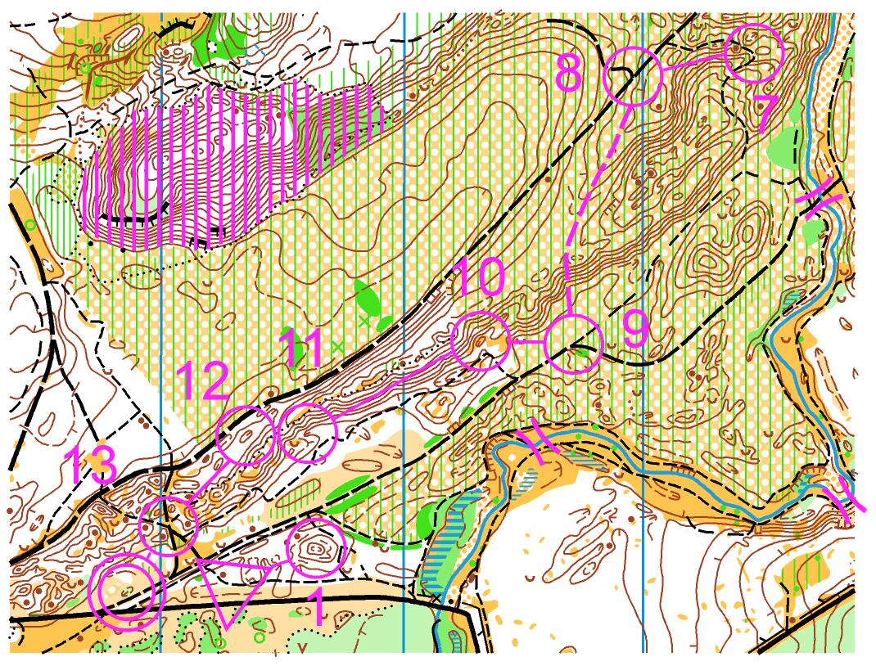
BETTER YELLOW LEGS
Tape 8-9 and 11-12
More interesting legs
Attack points for most controls
Limited route choice (12-13)

Slide 147
ORANGE COURSE
Course shall have route choice with prominent attack points near the control sites and/or catching features less than 100 m behind.
Control sites may be fairly small point features and the control markers need not necessarily be visible from the attack point.
Doglegs are not permitted.

Slide 148
ORANGE COURSE
Simple navigation by contours and rough compass with limited distance estimation required.
Use of a chain of prominent features as "stepping stones" is encouraged.
Used for: M/W14A, M/W16B, adult B classes

Slide 149
ORANGE COURSE TIPS
Think “stepping stones”, attack points and catching features for every leg.
Don’t just set really long legs across forest blocks.
Avoid areas of really detailed contours. Use larger, more easily understood features.

Slide 150
ORANGE COURSE TIPS
Notes:
Is 3-4 an orange leg?

Slide 151
RED COURSE
Navigation should be as difficult as possible.
However...consider varying shades of red. Should M/W16 or M/W70 be as extreme as M/W elite?
May not be able to set red courses on some maps.
Don’t make the course a test of vision rather than navigation.
Climb should not normally exceed 4%

Slide 152
RED COURSE – DO’s
Vary the leg length.
Vary the direction and shape of the course.
Vary the navigational skills required.
Include plenty of route choice and decision making.
Think about ALL possible route choices, not just yours. Helps to find a left, right and straight option for all legs. You’ll be amazed what you don’t initially see and what competitors will do.
Keep fairness at the forefront of your mind.
If unsure about fairness, move your control. Play it safe.

Slide 153
RED COURSE – DO’s
Include spectator legs where appropriate.
Make a drinks control easy access for vehicles.
Try to have one finish chute taped and all courses entering the last control from roughly the same direction and near to assembly area.
Start can be further away.
Pleasant, runnable forest - largely beyond the planners control, but do make good use of the nicest bits you've got, using a map exchange/map flip if need be.

Slide 154
RED COURSE – LONG vs MIDDLE
Middle distance courses should not simply be short long courses.
Long distance – physical endurance, route choice, longer legs but still have differing leg length. Control itself is the end-point of a demanding route choice leg and not necessarily difficult to find.
Middle distance – more technical, detailed navigation. Controls difficult to find, changes of direction and speed required. High concentration.

Slide 155
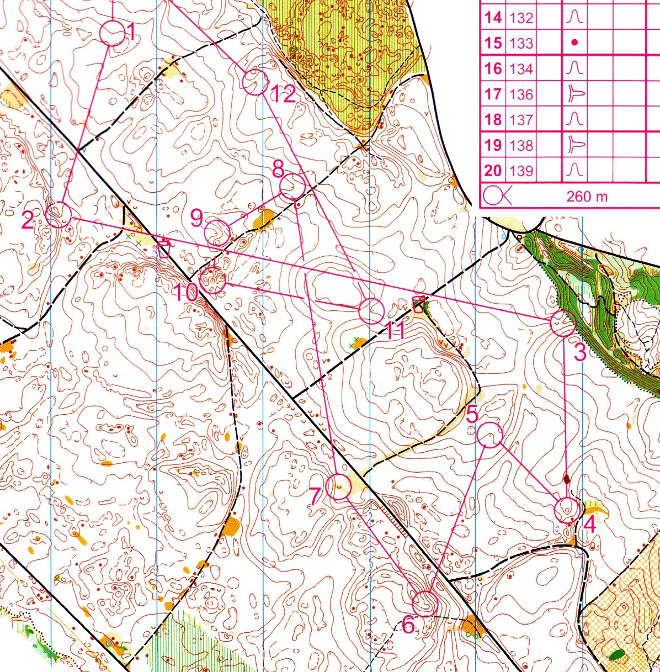
POOR RED COURSE

Slide 156
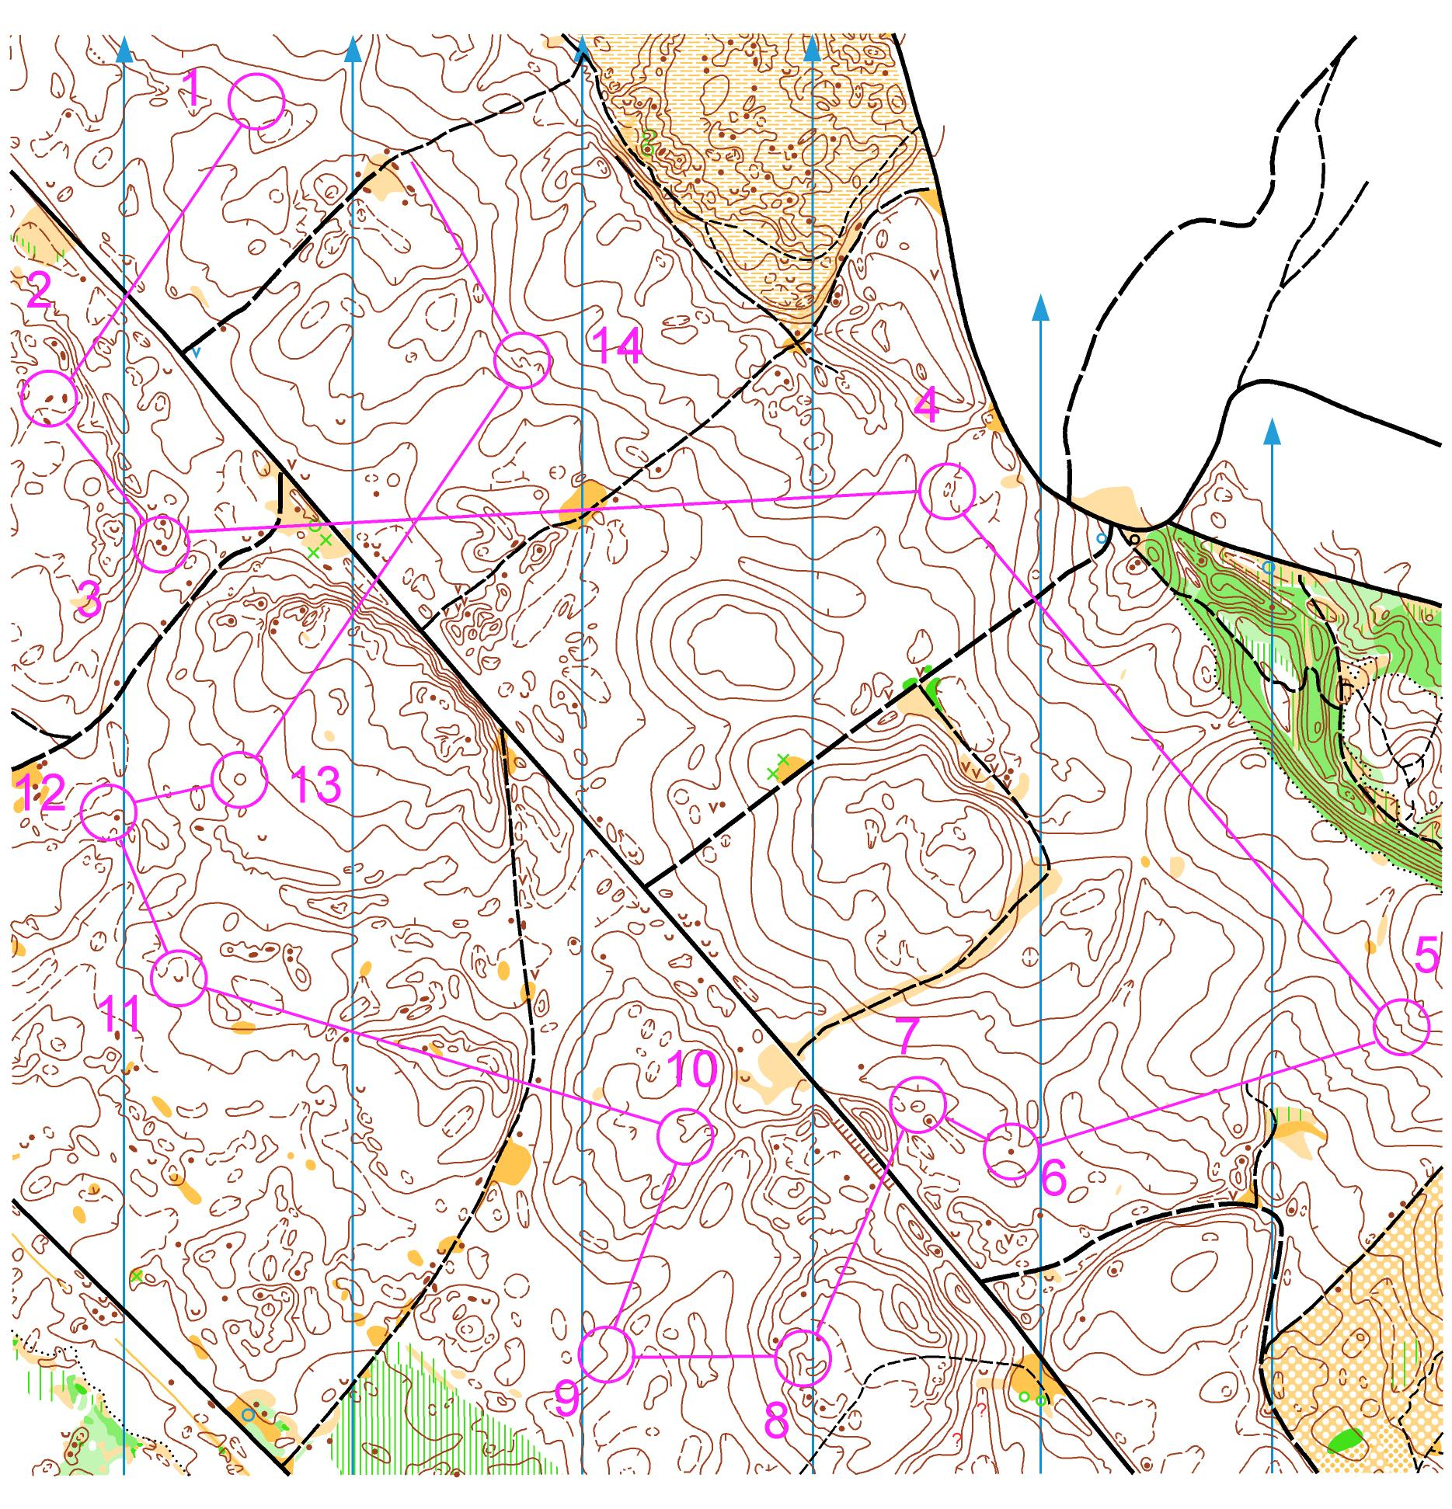
BETTER RED COURSE

Slide 157
NO-NOES Summary
No Dog-legs (on harder courses)
No legs that run in opposite directions on different courses
Should not approach controls from opposite directions (well planned too–see below)
No legs across ambiguous or dangerous areas – where there is any possibility for people to enter (see below)
Do not go near undefined edges of the map (see below)
Not too physical (or technical) for the target market
Below
Do not assume that a competitor will do the sensible thing, there will always be someone that does something you would never dream of

Slide 158
Course Lengths
Club events normally looking at pretty general ‘winning’ times e.g.
White 20mins
Yellow 30mins
Orange 40 mins
Short Red 45mins
Long Red 60 mins
Will be large variations in each course, not necessary setting for the 2-3 fastest that may turn up
How do you know how long the course should be?
Use km rate (mins per km)
If run on map before, look at old results and course lengths (if can find them)
Think of similar map(s) and look at results and lengths
Think of events you have done – take an educated guess
Look at full result list, not just winners, could give insight into if the course was too long (a couple of fast times but lots of really long as well), too hard (lots of dnf/mp), too popular? Maybe need another course?(lots of orange with a large spread in times, maybe need short and long orange courses?)

Slide 159
Overall
Fairness and safety are paramount
Correct technical level
Correct lengths
No No-noes
Controls are ‘correct’ (can be described)

